Slide 1
HOOF KY
Business Analysis
Team Swiftriver
(Trisia Baltazar, Adrian Boone, Chad Daily, Jann Jalando-on, Mate Kovacs, Joseph Morrison)

Slide 2
Agenda
Advertising and Marketing
Social Media
Calendar of Events
Contacts
Fundraising
FAQ
Missing Information
Volunteer Sign Up
Online Donations

Slide 3
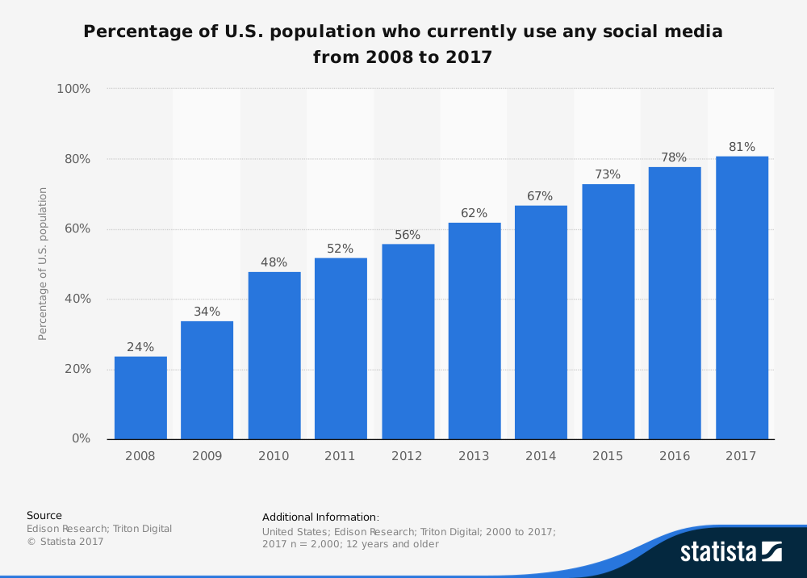
Advertising/Marketing: Social Media
Not time consuming
More time to work on organizational problems
Seek out more resources
Easily and quickly reach out to potential donors
81% of U.S population use social media
Ability to reach out to younger donors
Free marketing More traffic More donors

Slide 4
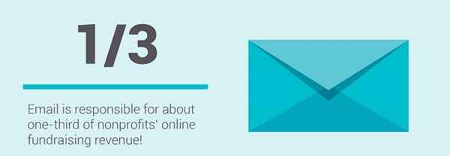
Advertising/Marketing
Total income from business and public donations (2016): $3,569
Possible Donations with Social Media Advertising: $3569 * (⅓)= $1070
Donations (Projected): $4639

Slide 5
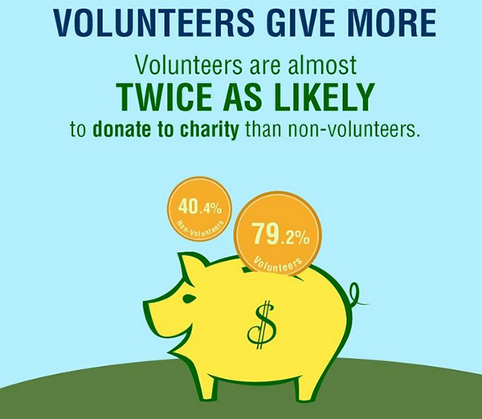
Advertising/Marketing
Lack of Calendar of Events Leads to Lost Profit
No notification of fundraising events
No notification of silent auction events
Assuming an Increase of Volunteers
Avg.Public Donation (no outliers)
$128 -> $40
2 - 5 - 10
Volunteer * (.79) *Avg. Donation
2 [1] = $40 5[3]= $120 10[7] = $280

Slide 6
Advertising/Marketing
Convenience = Clients
Clients
Volunteers
Customers
Fundraisers
Donors
Organizations (Grants)
Foundations
Fundraisers (2016) = $8,235.00
Foundations (2016) = $4,695.70
Increase by 5% - 10% - 25%
Fundraisers(Projected)
5% = $411.57
10% = $823.50
25% = $2,058.75
Foundations(Projected)
5% = $234.79
10% =$469.57
25% = $1,173.93

Slide 7
Contacts / Missing Information
Information about silent auction and volunteer signups
Not having this could deter possible volunteers and donors.
FAQ page
More information leads to more confident donors and volunteers.
Easy communication between employees
Adding an easy way for employees to communicate would improve efficiency and save a lot of time.

Slide 8
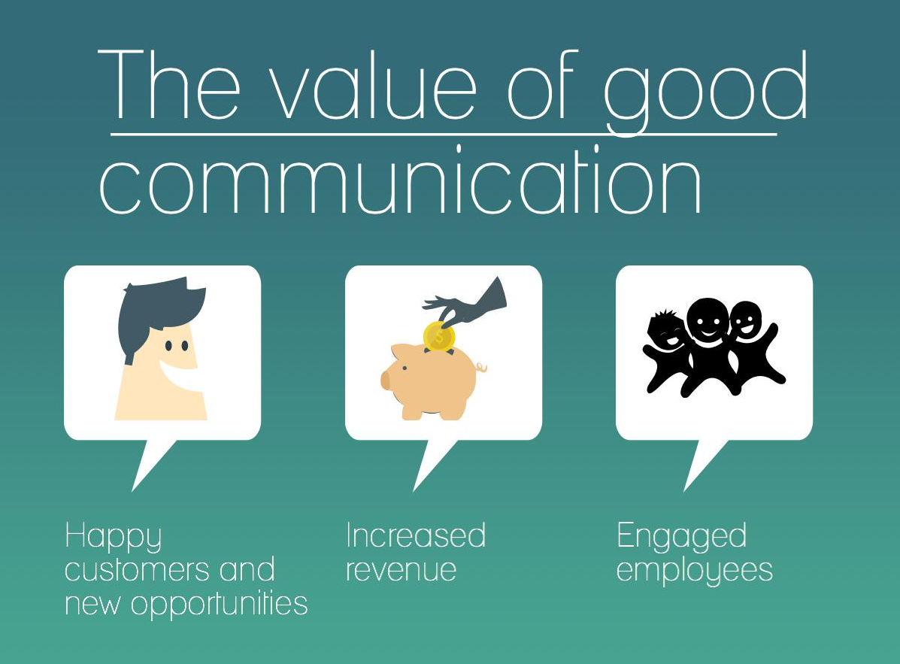
Contacts - Easy Communication
Need ways of communication between:
Board
Donors
Event attendees
Volunteers
Schools

Slide 9
Missing Information: Volunteer Sign Up
Adding Volunteer Sign-Up reduces time spent looking for volunteers.
Less time spent looking for volunteers equals more time spent writing grants.
Non-profit organizations average 3 grants
Time spent writing a grant
Assume ~ 24 hours (decreases as your write more)
Dollar value of grant
Current HOOF grant ~ $9000
Grant success rate
Assume 1 out of 3 grants

Slide 10
Missing Information: Volunteer Sign Up
Time spent looking for volunteers reduced by ~ 2 hours per week
24 hours per grant / 2 hours per week = 12 weeks
52 weeks per year / 12 = ~ 4 grants
4/3 = 1.33
1 successful for $9000
Next year, time to write grant decreases by 10-25%
10% = 21 hours 25% = 18 hours
21/2 = 10.5 weeks 18/2 = 9 weeks
52 / 10.5 = ~ 5 grants 52/9 = ~ 6 grants
5/3 = 1.667 6/3 = 2
Each would result in roughly 2 successful grants
2 successful grants = $18,000

Slide 11
Missing Information: Online Donations
Giving by individuals totaled an estimated $281.86 billion in 2016
72% of total donations
HOOF converted 8 public donations in 2016 into a total of $2,769.86
Increases by 5% - 10% - 25%
$2,769.86 (5%) = $138.49
$2,769.86 (10%) = $276.98
$2,769.86 (25%) = $692.47

Slide 12

Missing Information: Online Donations
Small nonprofits, with annual total fundraising less than $1 million, grew their online fundraising 8.1% compared to 2015
In 2016, 7.2% of total fundraising came from online giving
HOOF 2016 Total Donations = $15,700.56
$15,700.56 (7.2%) = $1,130.44

Slide 13
Any Questions?

Slide 14
Sources
https://www.statista.com/statistics/273476/percentage-of-us-population-with-a-social-network-profile/
http://www.nptechforgood.com/2015/09/16/20-must-know-fundraising-and-social-media-stats/
https://www.urban.org/sites/default/files/publication/24231/412962-Nonprofit-Government-Contracts-and-Grants-Findings-from-the-National-Survey.PDF
https://givingusa.org/wp-content/uploads/2017/06/Giving-USA-2017-Infographic.jpg
http://institute.blackbaud.com/wp-content/uploads/2017/02/2016-Charitable-Giving-Report.pdf

